Slide 1

6th Grade Accelerated Math
Unit 13, Lesson 12 Equivalent Expressions Using Properties of Operations Volume 2, pg. 327

Slide 2


Benchmark
MA.7.AR.1.2
Determine whether two linear expressions are equivalent.
volume 2, pg. 327

Slide 3
Integrated Mathematical Thinking and Reasoning Standards
MA.K12.MTR.4.1 Engage in discussions that reflect on the mathematical thinking of self and others.
MA.K12.MTR.5.1 Use patterns and structure to help understand and connect mathematical concepts.
volume 2, pg. 327

Slide 4

Learning Targets
I can use properties of operations to write equivalent forms of an algebraic expression.
I can determine whether two linear expressions are equivalent.
volume 2, pg. 327

Slide 5

Warm-Up
volume 2, pg. 327

Slide 6
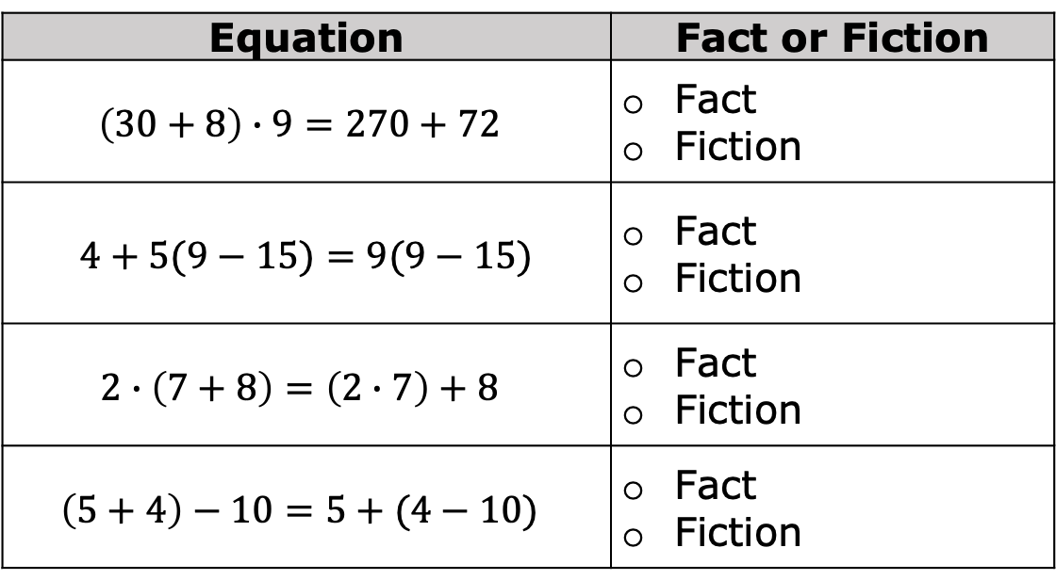
13.12.1 Warm-Up: Fact or Fiction?
Determine whether each equation below is fact (true) or fiction (false).
Equation | Fact or Fiction
$$\left(30+8\right)∙9=270+72$$ | Fact Fiction
$$4+5(9−15)=9(9−15)$$ | Fact Fiction
$$2∙\left(7+8\right)=\left(2∙7\right)+8$$ | Fact Fiction
$$\left(5+4\right)−10=5+(4−10)$$ | Fact Fiction
volume 2, pg. 327

Slide 7

Refresher
volume 2, pg. 328

Slide 8

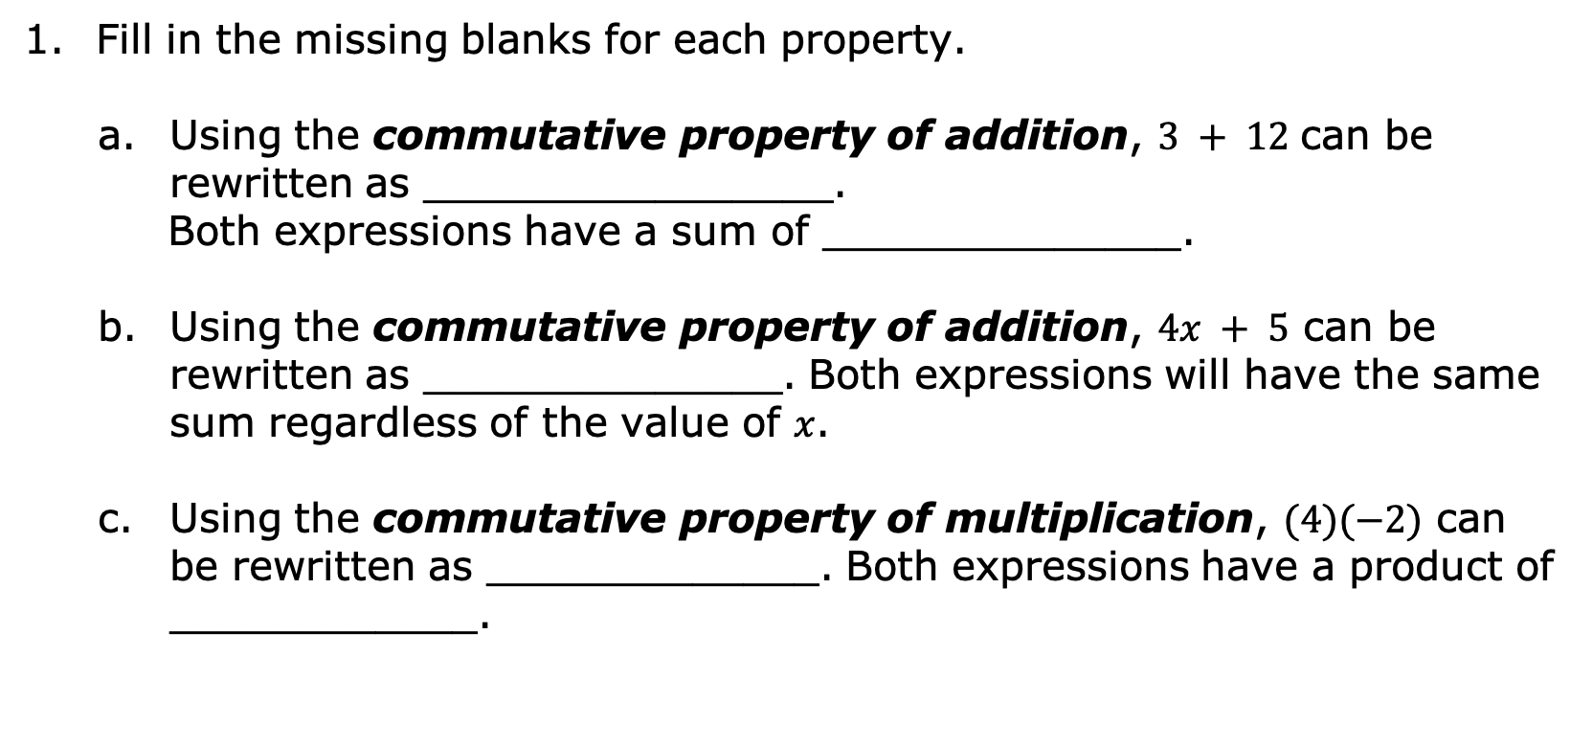
13.12.2 Refresher: Rewriting Expressions Using Properties of Operations
Fill in the missing blanks for each property.
Using the commutative property of addition, $3 + 12$ can be rewritten as ________________.
Both expressions have a sum of ______________.
Using the commutative property of addition, $4x + 5$ can be rewritten as ______________. Both expressions will have the same sum regardless of the value of $x$.
Using the commutative property of multiplication, $(4)(−2)$ can be rewritten as _____________. Both expressions have a product of ____________.
volume 2, pg. 328

Slide 9
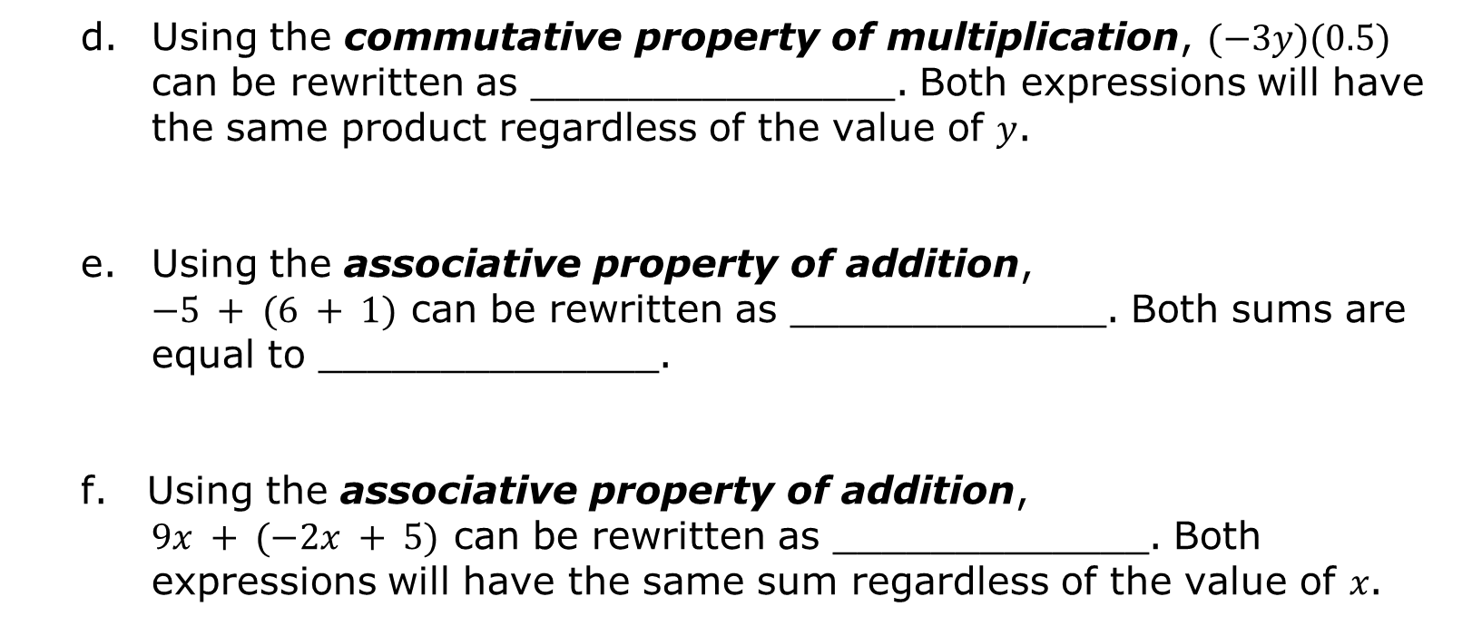
Using the commutative property of multiplication, $(−3y)(0.5)$ can be rewritten as _______________. Both expressions will have the same product regardless of the value of 𝑦.
Using the associative property of addition,
$−5 + (6 + 1)$ can be rewritten as _____________. Both sums are equal to ______________.
f. Using the associative property of addition,
$9x + (−2x + 5)$ can be rewritten as _____________. Both expressions will have the same sum regardless of the value of 𝑥.
volume 2, pg. 328

Slide 10
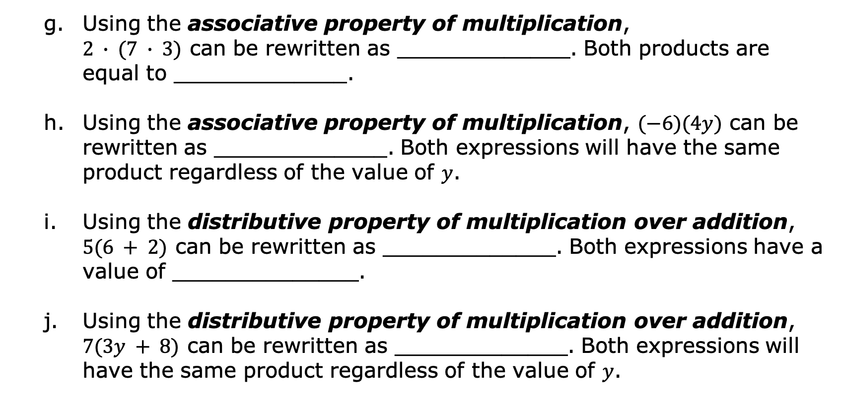
Using the associative property of multiplication,
$2 ∙ (7 ∙ 3)$ can be rewritten as _____________. Both products are equal to _____________.
Using the associative property of multiplication, $(−6)(4y)$ can be rewritten as _____________. Both expressions will have the same product regardless of the value of 𝑦.
Using the distributive property of multiplication over addition, $5(6 + 2)$ can be rewritten as _____________. Both expressions have a value of ______________.
Using the distributive property of multiplication over addition, $7(3y + 8)$ can be rewritten as _____________. Both expressions will have the same product regardless of the value of 𝑦.
volume 2, pg. 328

Slide 11
Discuss with your partner why the associative property and the commutative property do not hold true for subtraction and division. Give an example of each to show mathematically that these properties do not apply to subtraction and division.
volume 2, pg. 328

Slide 12
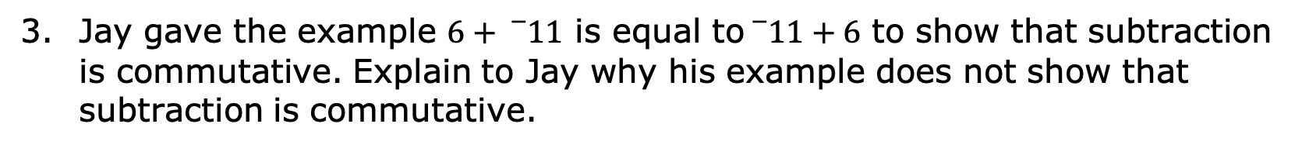
Jay gave the example $6+{}_{}^{−}{11}$ is equal to${}_{}^{−}{11}+6$ to show that subtraction is commutative. Explain to Jay why his example does not show that subtraction is commutative.
volume 2, pg. 329

Slide 13

Guided Instruction
volume 2, pg. 329

Slide 14
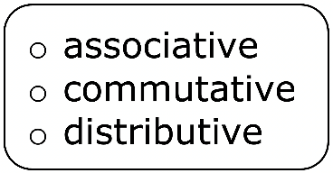
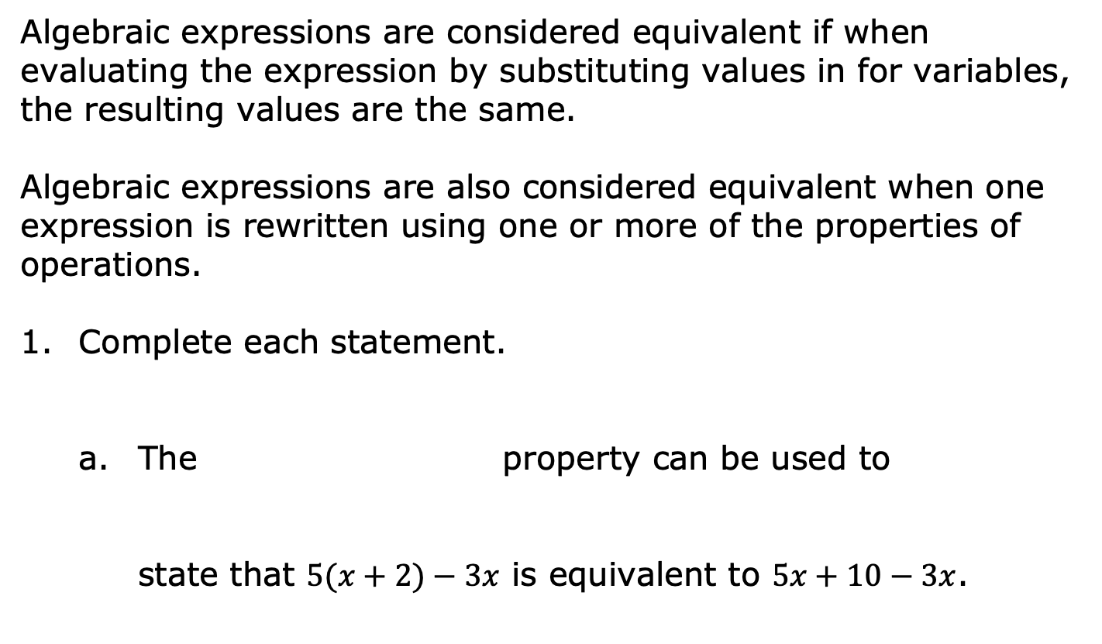
13.12.3 Guided Instruction: Equivalent Expressions Using Properties of Operations
Algebraic expressions are considered equivalent if when evaluating the expression by substituting values in for variables, the resulting values are the same.
Algebraic expressions are also considered equivalent when one expression is rewritten using one or more of the properties of operations.
Complete each statement.
The property can be used to
state that $5(x+2)−3x$ is equivalent to $5x+10−3x$.
volume 2, pg. 329

Slide 15
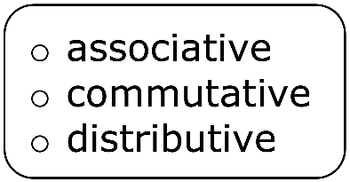
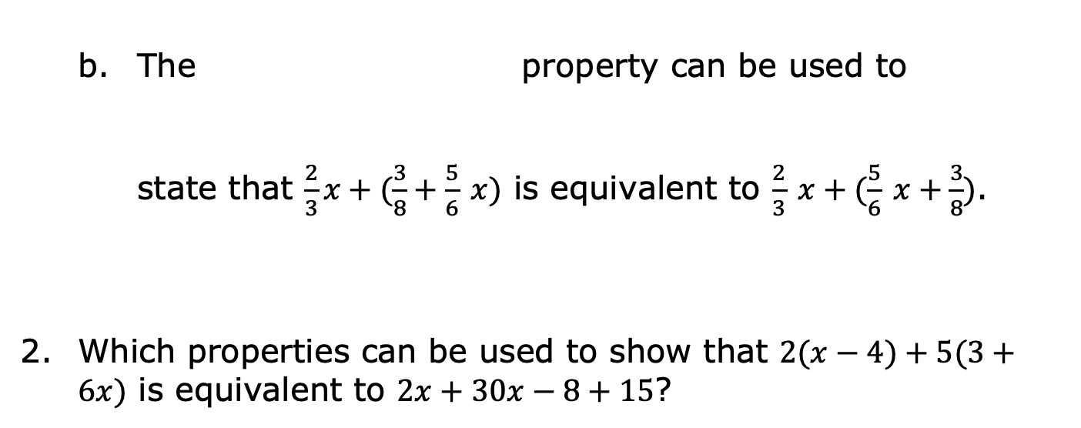
The property can be used to
state that $\frac{2}{3}x+(\frac{3}{8}+\frac{5}{6} x)$ is equivalent to $\frac{2}{3} x+(\frac{5}{6} x+\frac{3}{8})$.
Which properties can be used to show that $2(x−4)+5(3+6x)$ is equivalent to $2x+30x−8+15$?
volume 2, pg. 329

Slide 16

Guided Practice
volume 2, pg. 330

Slide 17

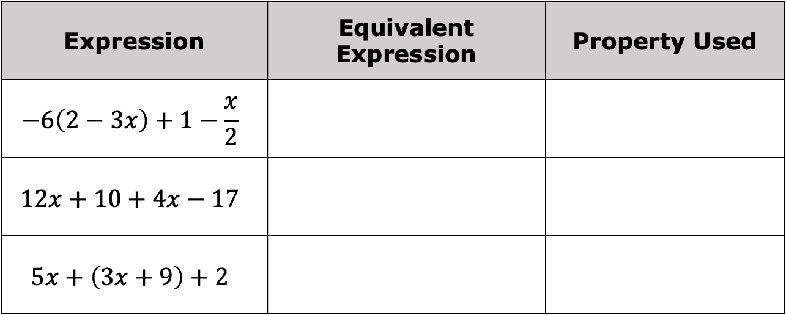
13.12.4 Guided Practice: Rewriting Expressions Using Properties of Operations
Write an equivalent expression using a property of operations. State the property used.
Expression | Equivalent Expression | Property Used
$$−6\left(2−3x\right)+1−\frac{x}{2}$$
$$12x+10+4x−17$$
$$5x+\left(3x+9\right)+2$$
volume 2, pg. 330

Slide 18
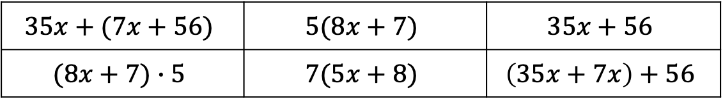
Several expressions are given below. Determine which expressions are equivalent using properties of operations.
$$35x+(7x+56)$$ | $$5(8x+7)$$ | $$35x+56$$
$$(8x+7)∙5$$ | $$7(5x+8)$$ | $$\left(35x+7x\right)+56$$
Complete the table by writing the expressions that are equivalent based on the property used.
Equivalent Expressions |  | Property Used
 |  | Associative Property
 |  | Commutative Property
 |  | Distributive Property
volume 2, pg. 330

Slide 19

Your Turn
volume 2, pg. 330

Slide 20
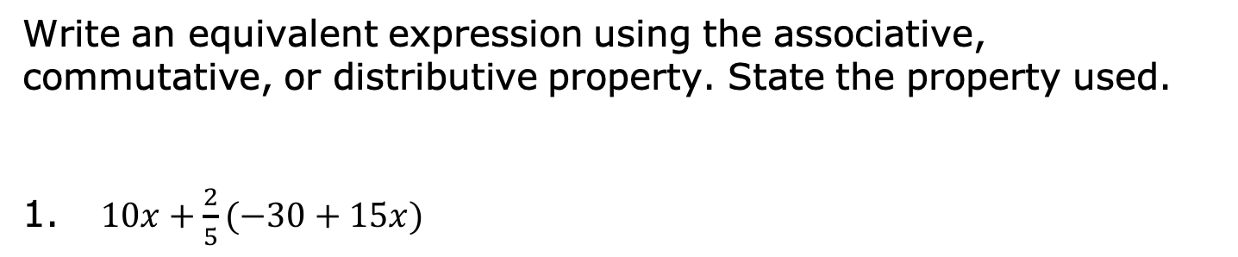
13.12.5 Your Turn!
Write an equivalent expression using the associative, commutative, or distributive property. State the property used.
$10x+\frac{2}{5}(−30+15x)$
volume 2, pg. 330

Slide 21

$(18x+15)+4x−17$
$\left(−\frac{1}{5}x + 6\right)∙ 5$
volume 2, pg. 330

Slide 22

$\frac{5}{4}n+\frac{7}{3}−\frac{11}{2} n−12 \frac{1}{3}$
$−3\left(\frac{1}{2}x + 4\right) − \frac{3}{5} (−1 + 10x)$
volume 2, pg. 331

Slide 23

Wrap-Up
volume 2, pg. 331

Slide 24
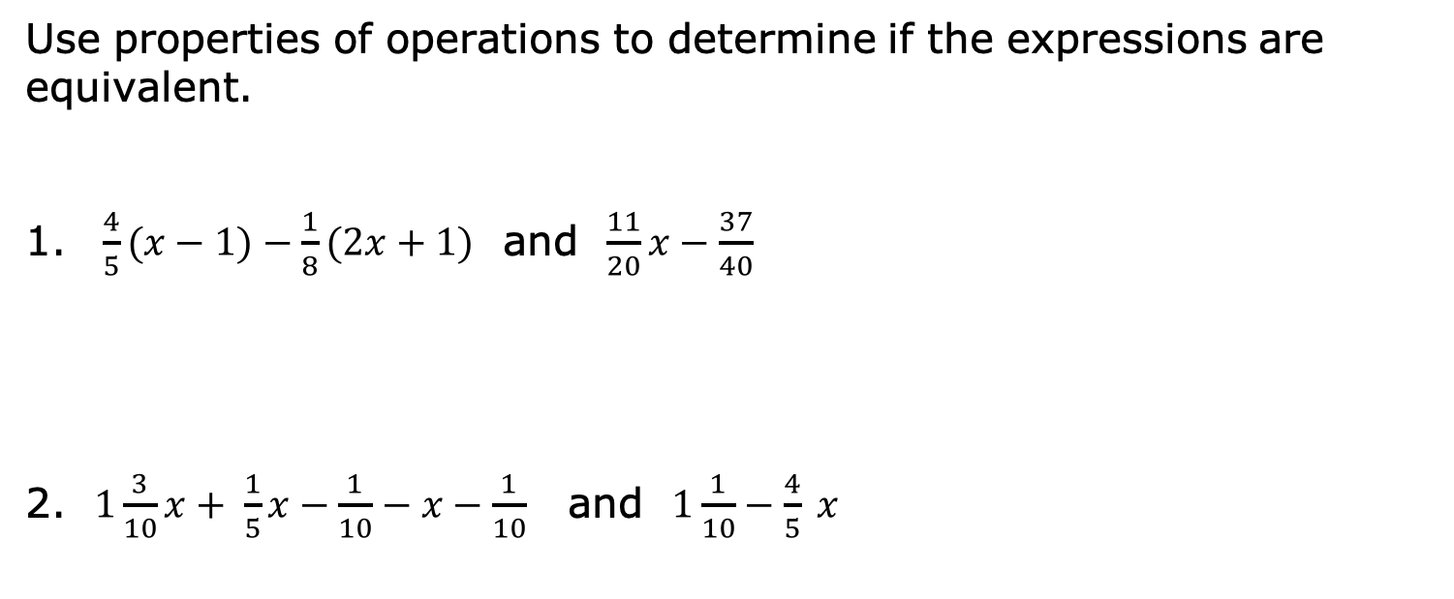
13.12.6 Wrap-Up: Ticket Out the Door
Use properties of operations to determine if the expressions are equivalent.
$\frac{4}{5}(x−1)−\frac{1}{8}(2x+1)$ and $\frac{11}{20}x−\frac{37}{40}$
$1\frac{3}{10}x+ \frac{1}{5}x−\frac{1}{10}−x−\frac{1}{10}$ and $1\frac{1}{10}−\frac{4}{5} x$
volume 2, pg. 331

